Slide 1
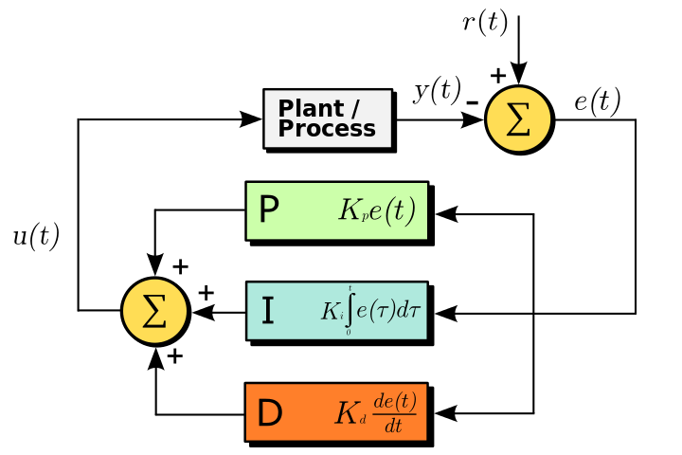
PID Control
The Proportional, Integral, Derivative (PID) control is used widely in control systems applications to design closed loop control systems.
Wide areas of application of the PID control involve cruise control, or design and control of rockets, stabilization of aircrafts.

Slide 2
We use the PID controller in our project to ensure that the motion of the quadrotor is smooth and it reaches the estimated coordinates without overshoot or errors.
Smoothest possible motion of the quadrotor for our project ensures that the estimation of the next coordinate is smooth and there is no accumulation in error.

